Slide 1
Early Literacy Skills- Nursery

Slide 2

Early Years Foundation Stage (EYFS)
Between 0-5 (Ends at the end of your child's Reception Year before they go into Year 1- KS1)
Mixture of Adult Led and Child Initiated Learning
Equal balance of both indoor and outdoor learning
Seven Areas of learning which are split into prime and Specific

Slide 3
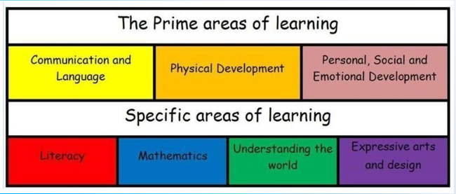
Prime and Specific areas

Slide 4
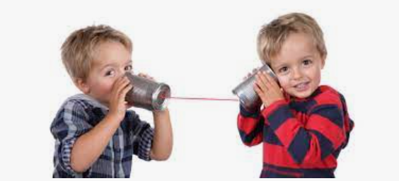
Communication and Language
Golden thread which underpins every area.
Vocabulary at 4 and a half years strongest correlation for future academic success
Milestones:
- 1 and a half to 2 years children will say 50 words but will understand between 250 to 500 words. They will start to put words together to make very short sentences.
- 3 years will use around 300 words but will understand around 1000! They will put 4 and 5 words together, understand plurals, past tense and will understand language relating to size, quantity and positioning.
- 4 years will use around 1500 words, will understand and follow three part instructions and will connect sentences using words such as ‘and’ and ‘because’.
TALK, TALK, TALK!!

Slide 5
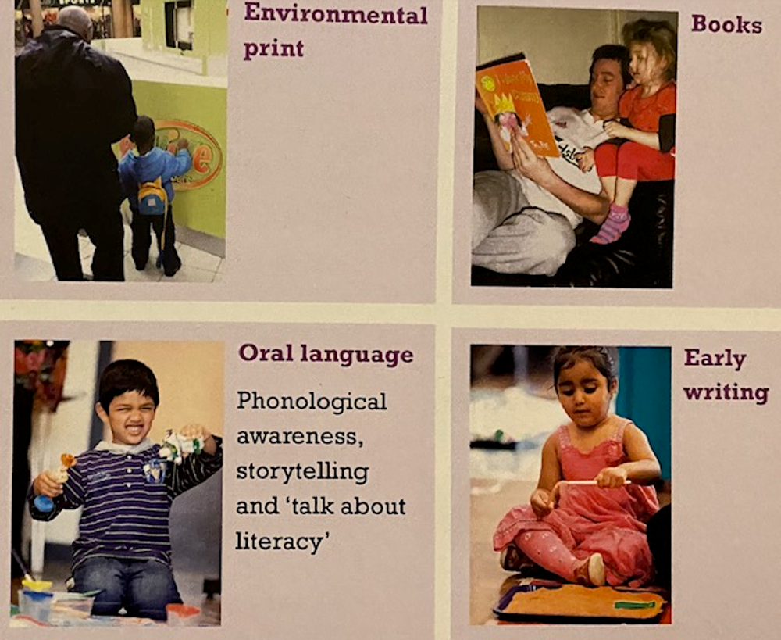
Raising Early Achievement in Literacy

Slide 6
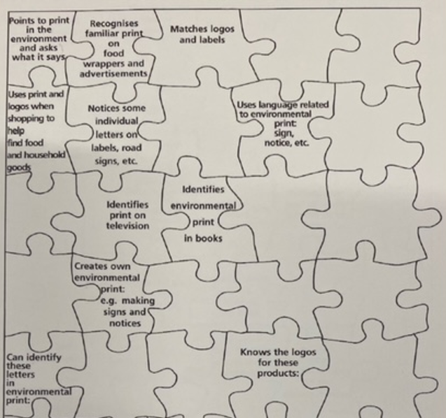
Environmental Print

Slide 7
How can you help at home?
Look at print in shops and in the street, on food packets and on road signs while going on journey’s
Take photographs of everyday logos such as ASDA, Aldi, Batman symbol and stick them into a scrap book.
Join in with your child play, listen and talk.
Matching logo games.
Go on a print hunt.
Make letters and words with playdough.
Highlight different print and logos and explain to your child why you are reading them e.g I’m just going to have a look at the bus timetable to see when the next bus is.

Slide 8
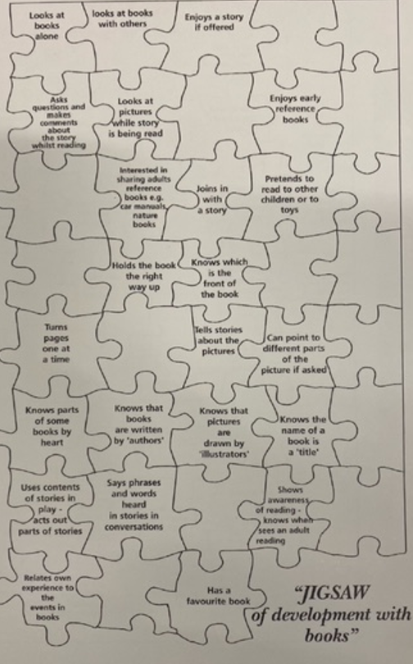
Books

Slide 9
What can you do at home to help?
Join the local library.
Regularly change your choice books in Nursery.
Have a special box or shelf to store your child’s books.
Use toys and puppets to act out stories.
Encourage your child to join in when you share books together.
Let you child hold the book while sharing stories and turn the pages.
Talk about the meaning of unfamiliar words, talk bout the pictures and compare to their lives.
Share the story in your childs first language
Model you reading for a purpose to your child.

Slide 10
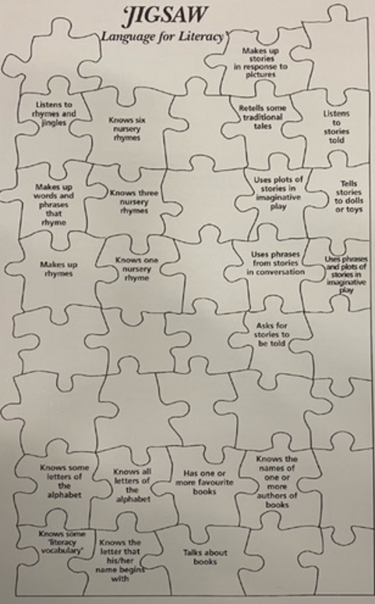
Oral Language

Slide 11
What can you do at home to help?
Access rhyme and story sessions at your local library.
Practise focused nursery rhymes sent home on the curriculum letter ( if unsure access http://bookstart.org.uk/ )
Make up stories together.
Act out familiar stories together.
You start to sing rhymes and encourage your child to finish.
Clap/ tap the beat to different rhymes and songs.
Share your favourite songs and stories with your child.

Slide 12
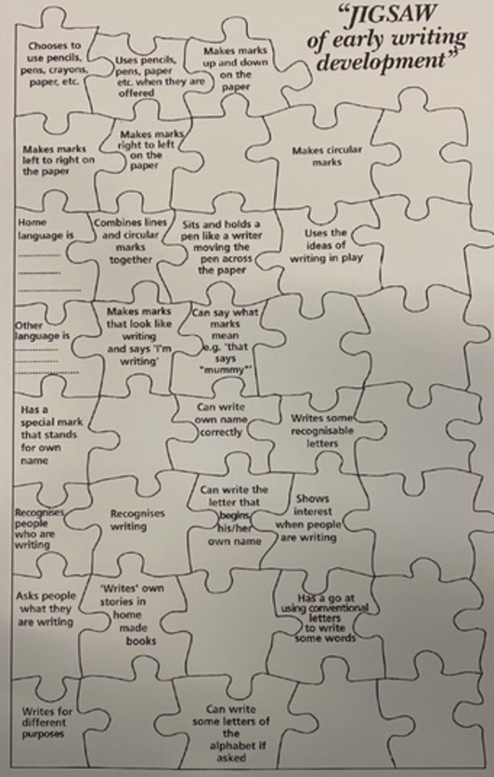
Early Writing

Slide 13
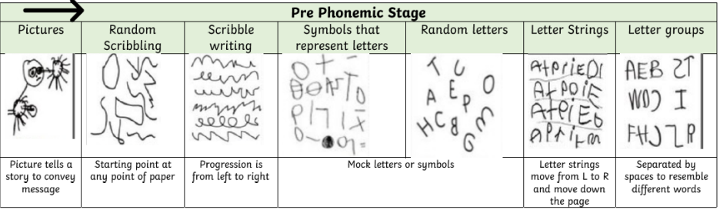
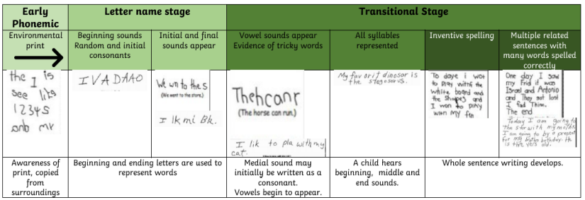
Stages of writing

Slide 14
What can you do to help at home?
Take your child to the park.
Ensure you have simple mark making equipment at home for your child to experiment with.
Make large marks outdoors using chunky chalks and natural objects such as sticks.
Footprints in the mud.
Paint with water and a brush
Value every piece of mark making your child does and display it somewhere at home.
Encourage your child to make marks for a purpose.
Model writing infront of your child and explain the purpose.

Slide 15
Questions
?

